Slide 1
Management Information Systems COSC572
Data Management in Social Business
Assessment 2
Submitted To
Matthew Wysel
Teacher, UNE
Submitted By
Bikash Neupane
220245756

Slide 2

The Power of Data in the Digital Age
How does Humanitix harness this power?

Slide 3

Objectives & Strategies of Data Management

Slide 4

Objective Enhance the ticketing experience

Slide 5
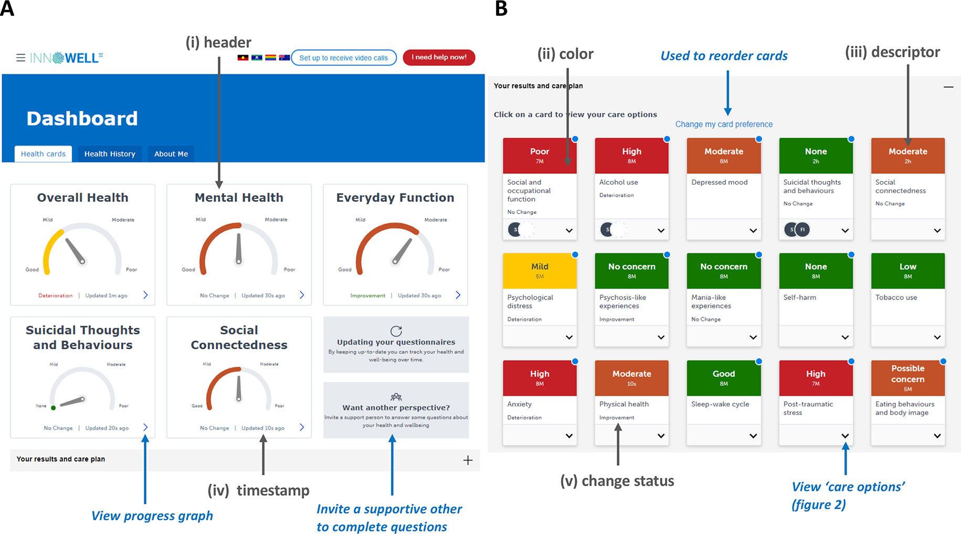
Strategy 1: Personalization

Slide 6

Strategy 2: Philanthropy

Slide 7

Strategy 3: Feedback Loop

Slide 8

Technical Provision of Data Management
Ensuring seamless and secure experiences

Slide 9

Robust IT Infrastructure

Slide 10

Security Protocols

Slide 11

Cloud Storage Solutions
This Photo by Unknown Author is licensed under CC BY

Slide 12

The Function of Data Management Systems

Slide 13

Operational Efficiency

Slide 14

Strategic Alignment

Slide 15

User Experience Enhancement

Slide 16

Impact of Humanitix's Strategies

Slide 17

Positive Impacts

Slide 18

Areas for Consideration

Slide 19

The Road Ahead for Humanitix
Harnessing data for a brighter, impactful future

Slide 20
References
Laudon, K. C., & Laudon, J. P. (2021). Management Information Systems: Managing the Digital Firm. Pearson.
Watson, H.J. (2014). Data Management: Databases and Organizations. Wiley.
Davenport, T.H. (2013). Analytics in Action. MIT Press.
Smith, A. (2018). Ethical Considerations in Digital Age. Oxford University Press.

